Slide 1
Project: CozyHaven – Hotel Booking
Project By: Charmila A B
Trainer By: Javeed Mohammed

Slide 2
Technologies Used
For Backend:
Java Spring Boot
For Frontend:
React.js
For Database:
MySql
For Authentication:
JSON Web Tokens(JWT)

Slide 3
Introduction About the Project
The Cozy Haven Hotel Booking System is a web application that simplifies and streamlines the hotel booking process, allowing administrators to manage hotels and customers to easily view and book rooms online. The system is designed to be secure, fast, and user-friendly.
Backend: Developed using It provides REST APIs to handle hotel management. For security, Spring Boot. JWT (JSON Web Token) authentication is implemented to ensure that only authorized users can access protected features.
Frontend: Developed using ReactJS, which provides an interactive and responsive UI. React is used for routing, forms, data binding, and client-side validations, ensuring a smooth booking experience.

Slide 4
User Roles
1. Admin
The Admin is responsible for managing the hotel data and services. The Admin can:
Add, edit, and delete hotels.
Add rooms for a particular hotel.
Add transport services for hotels.
View all bookings made by customers.
2. Customer
The Customer interacts with the system to make hotel reservations. The Customer can:
View all hotels on the main page.
Check hotel facilities and details (Wi-Fi, dining, parking, etc.).
Quickly book a hotel by selecting rooms, dates, and making the payment.

Slide 5
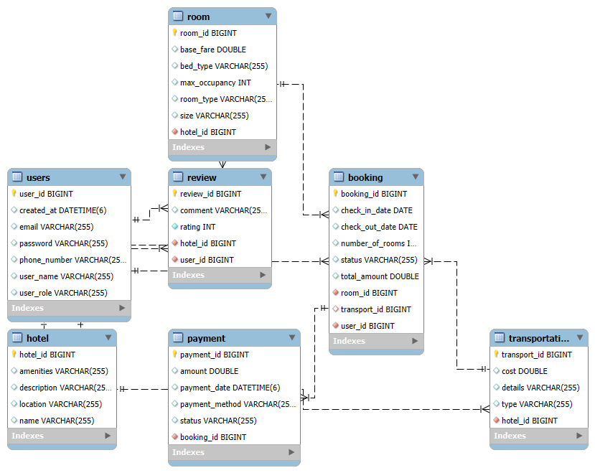
ER Diagram

Slide 6
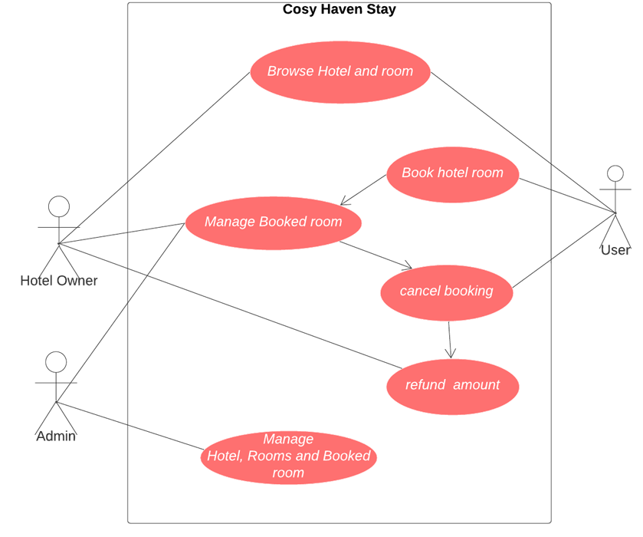
Use Case Diagram

Slide 7
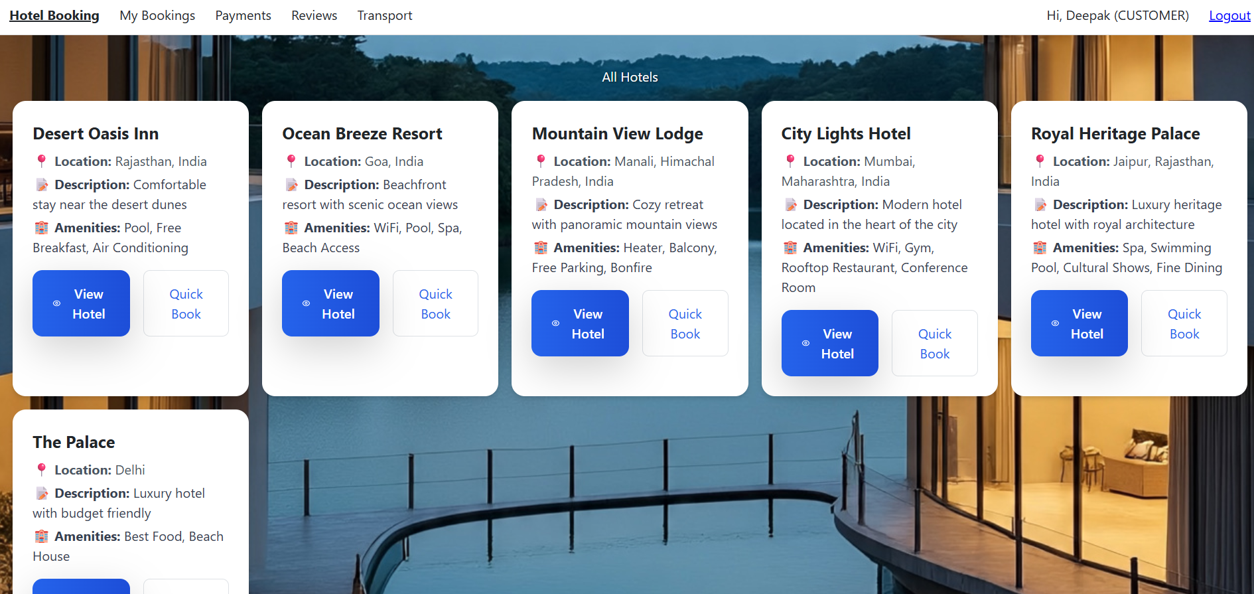
Output Screenshots For Validation

Slide 8
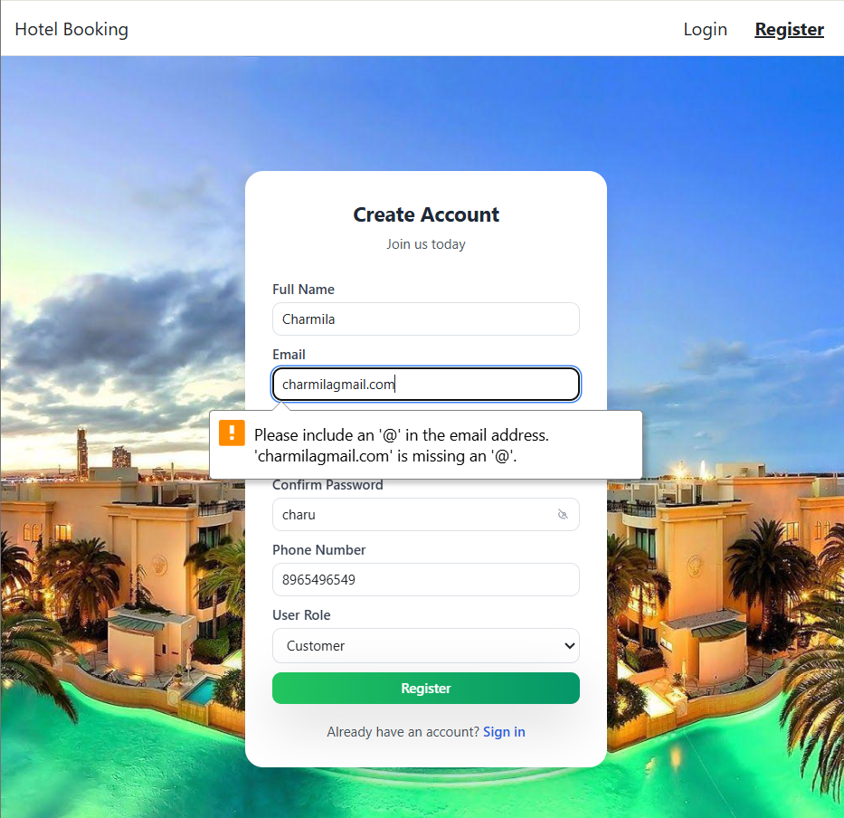
Validation is done in Email

Slide 9
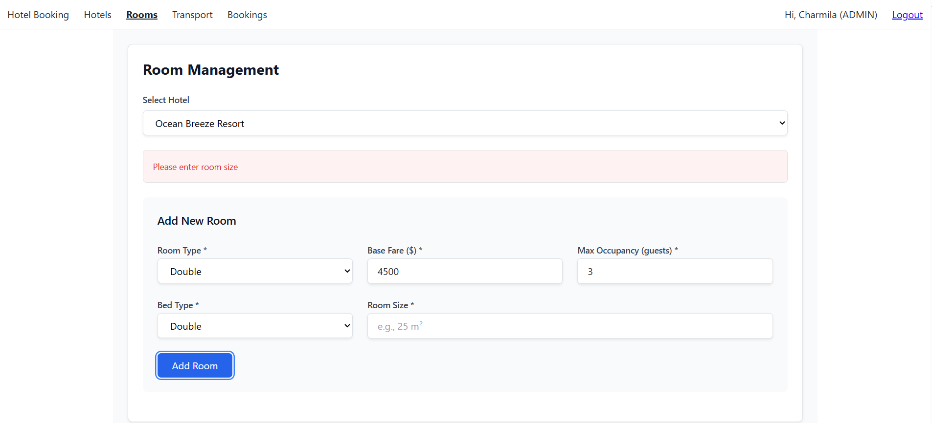
Validation is done in room management

Slide 10
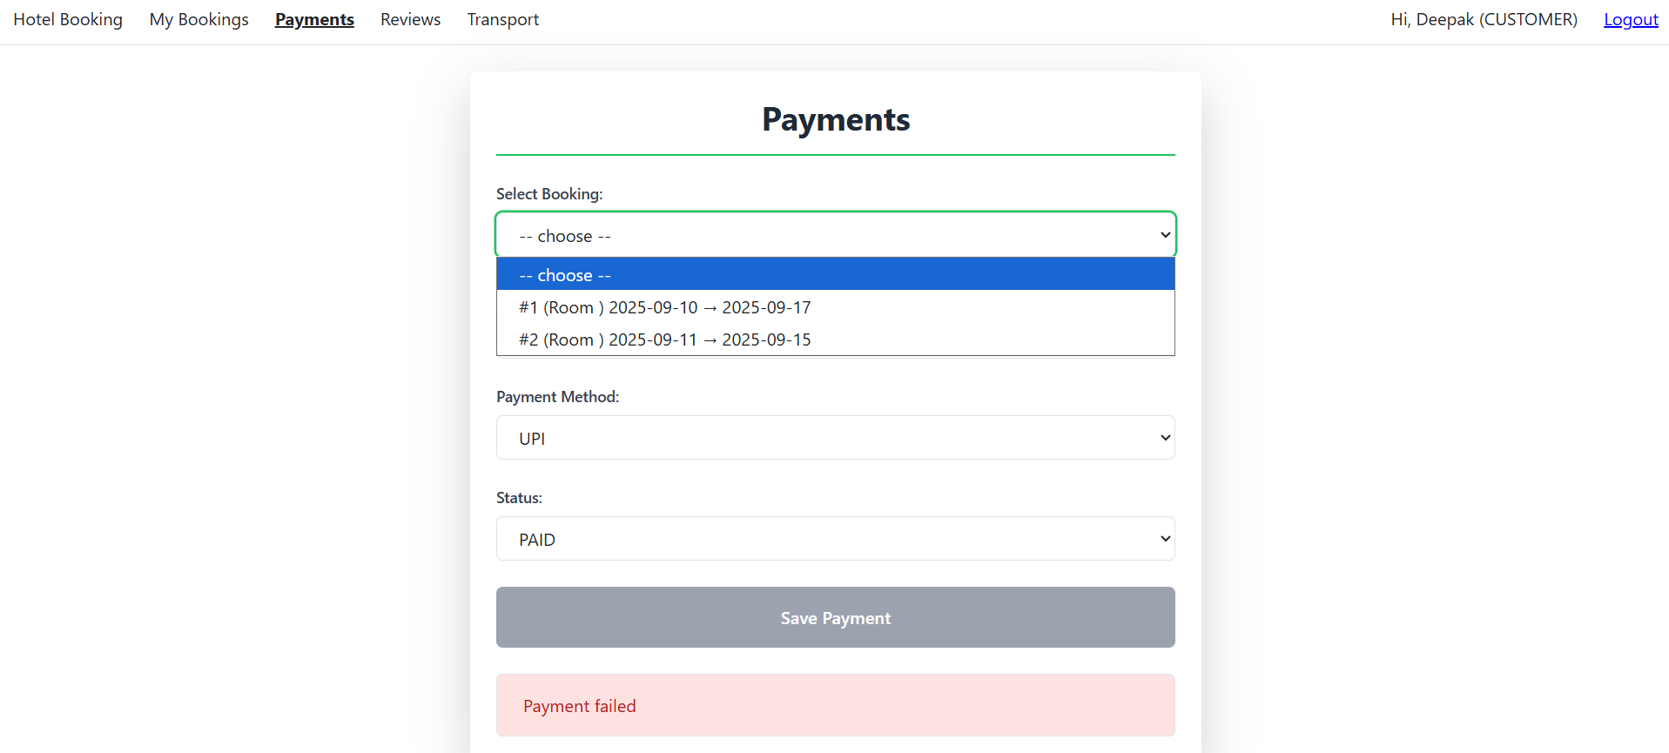
Validation is done in Payments

Slide 11
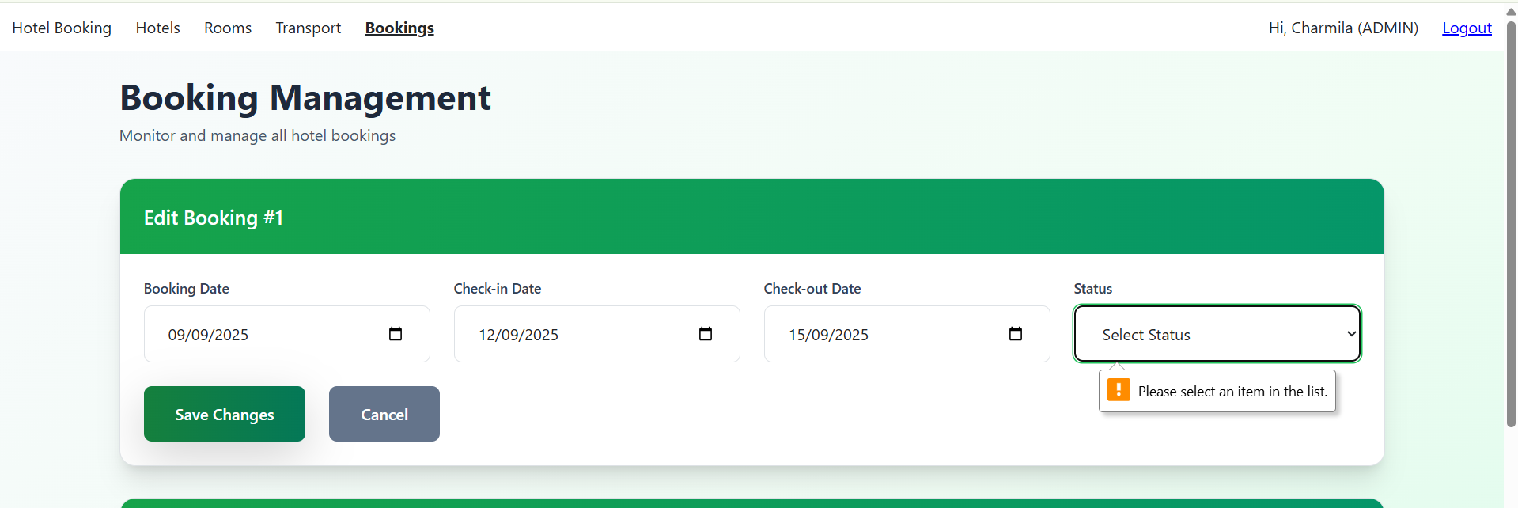
Validation is done in Booking Management

Slide 12
THANK YOU!

